Slide 1

project

Slide 2
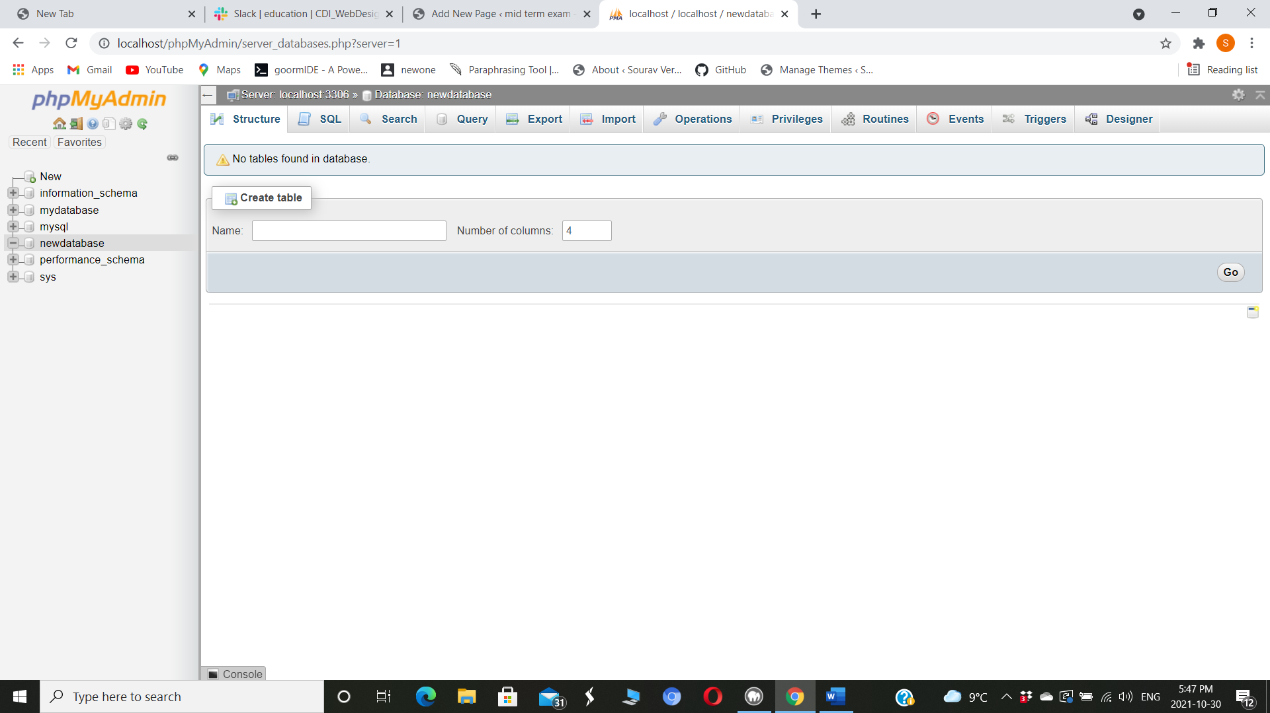
Database
To create a database you have to go to local host on google then you will have to create a new database file so then it will be made. Once you made a database you can create a table in it.

Slide 3
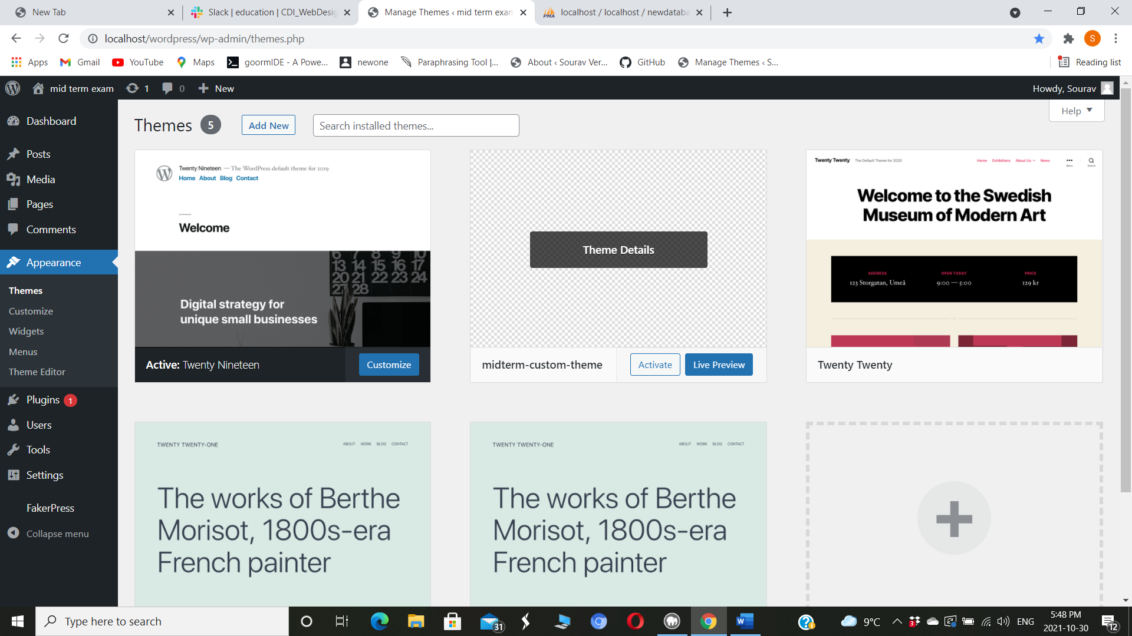
Custom Themes To create a custom theme you have to go to themes folder in c drive so once you will be there you have to create a new folder then make files like which in other folders so once you make it zip the folder then go in themes in wordpress and add a new theme and it will be there.

Slide 4
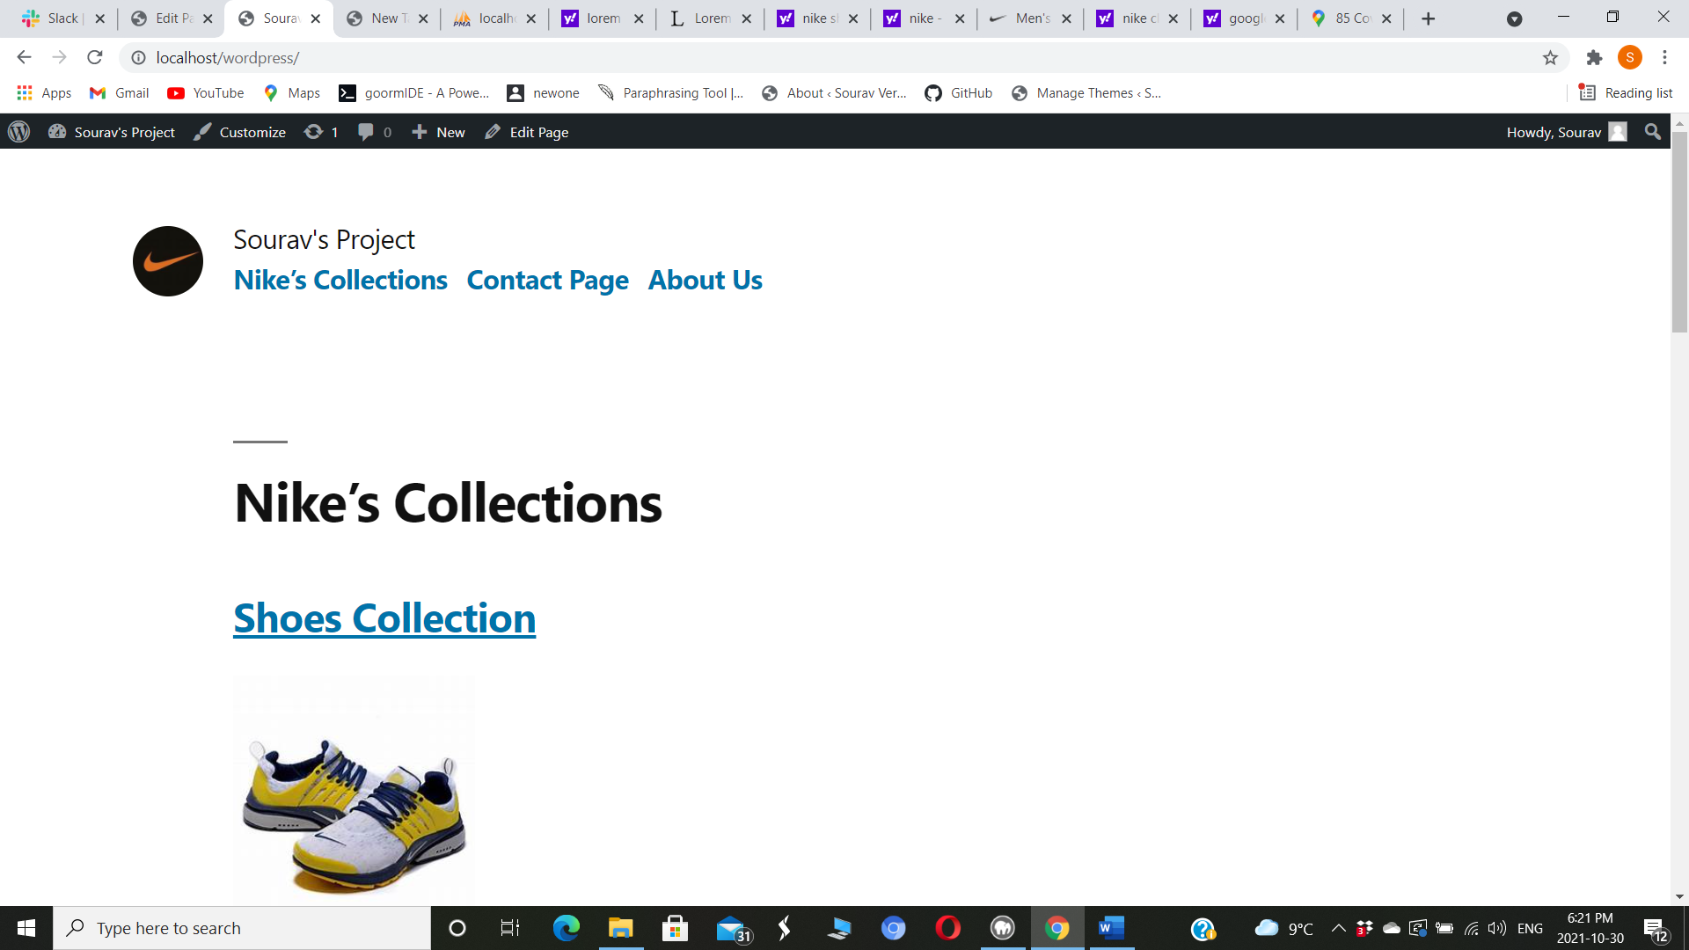
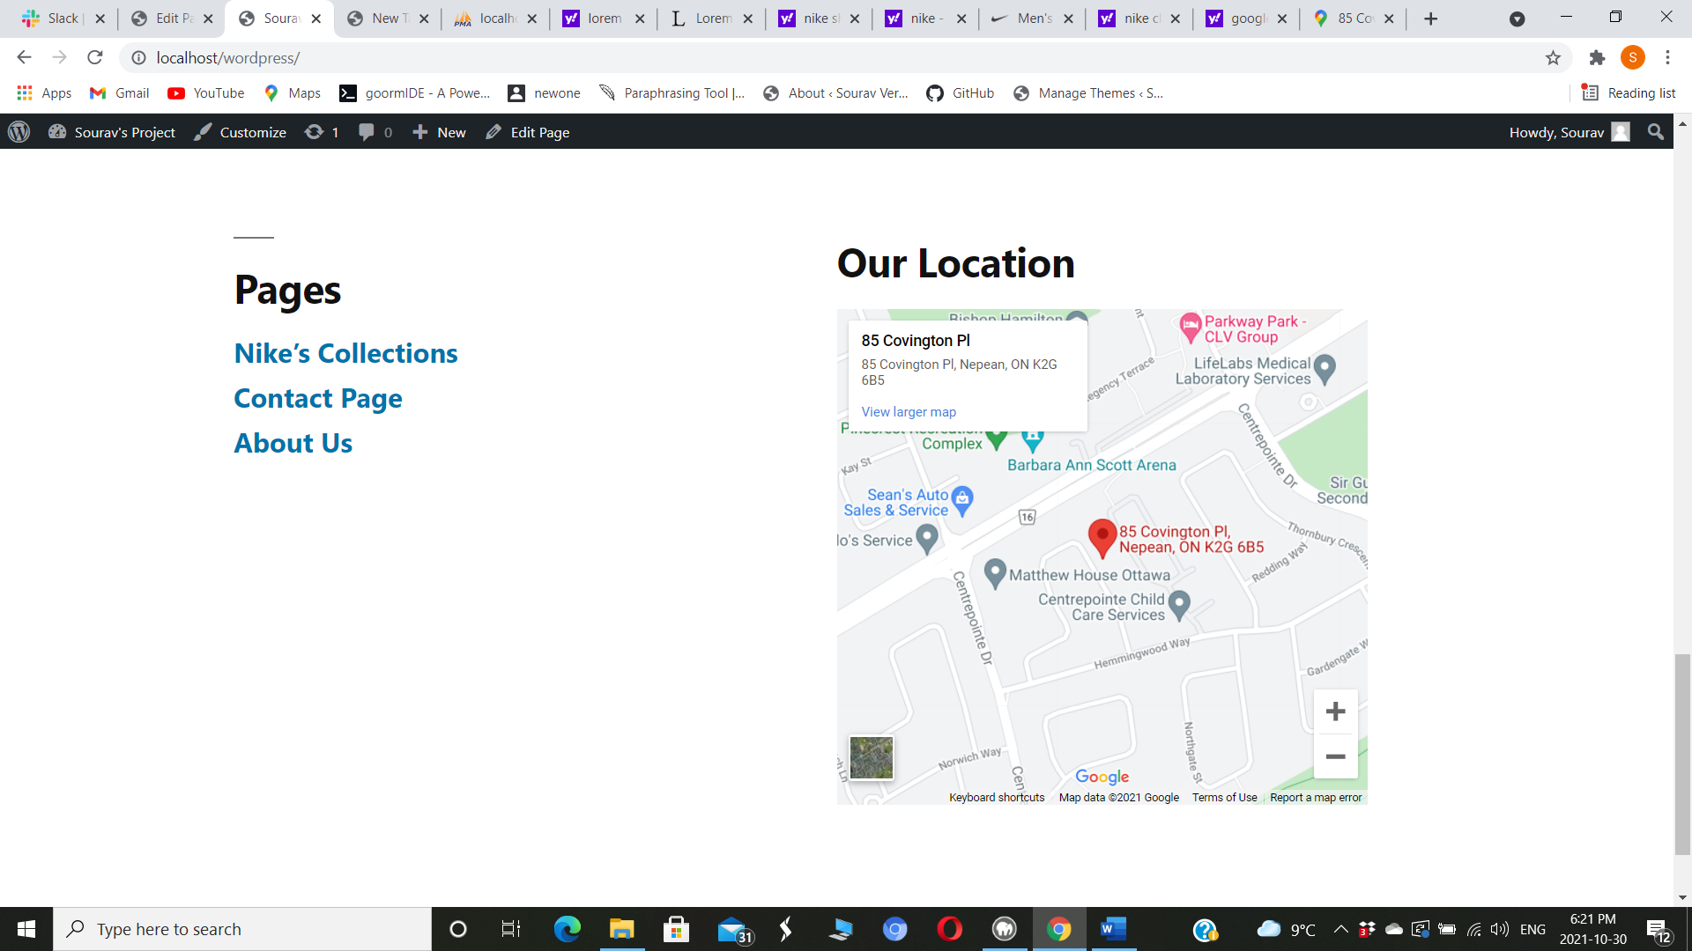
Header and footer To create header and footer you have to make it in wordpress once you create the page then you can edit the header and footer.

Slide 5
Fakerpress Download the plugin https://wordpress.org/plugins/fakerpress/ Unzip it and copy it to WordPress plugins folder FakerPress visible from the dashboard lateral menu

Slide 6
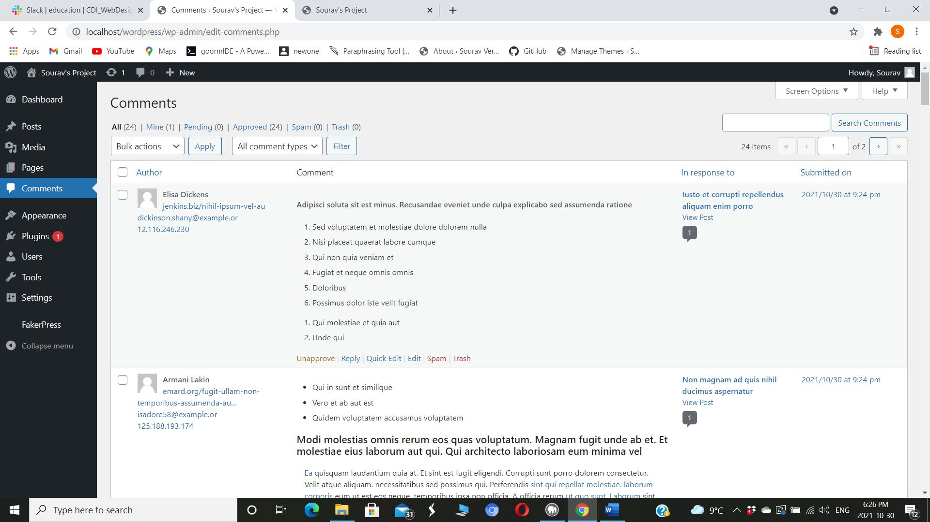
Posts and Comments To create posts go to posts in fakerpress and type the numbers where its written then click on generate so once its generated go on posts and create the posts in the same way so once you create go to posts there you will see there will fake posts which were created by you and on that posts there will be comments.

Slide 7
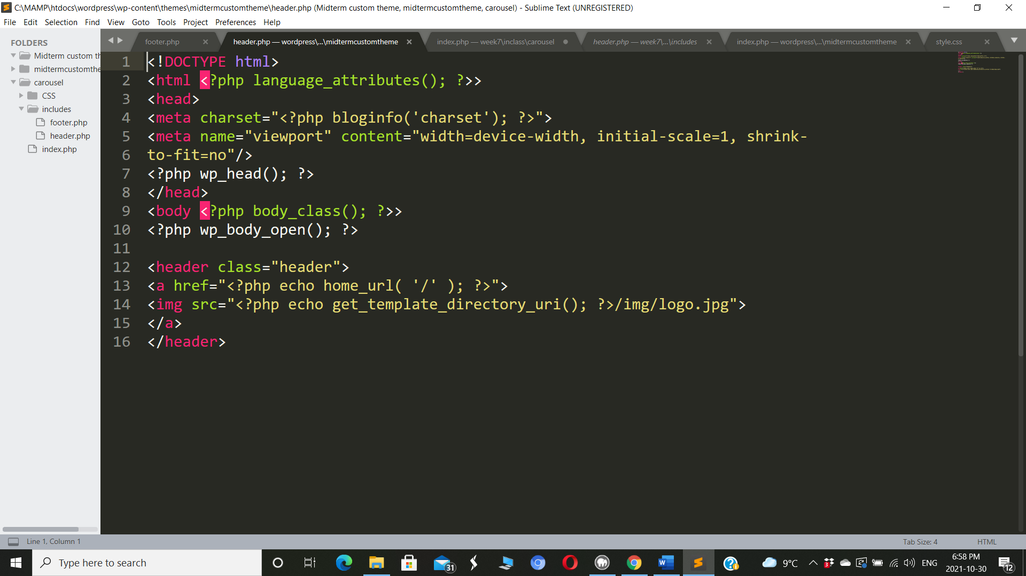
HTML To make changes in header and footer you have to change in html so once you change it the code is set to go.

